Slide 2
WHAT IS FILE?
A file is a collection of data stored in one unit, identified by a filename. It can be a document, picture, audio or video stream, data library, application, or other collection of data. Files can be opened, saved, deleted, and moved to different folders. They can also be transferred across network connections or downloaded from the Internet.
WHAT IS DIRECTORY?
A directory is another name for a folder. File systems use directories to organize files within a storage device.
Directories are two types:
Rootdirectory,
Subdirectory.

Slide 3
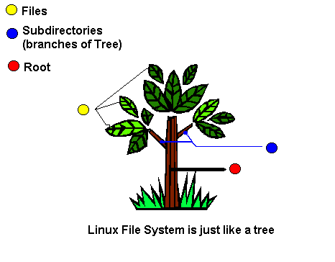
ROOTDIRECTORY:
The root directory is the top-level directory of a file system.
The directory structure can be visually represented as an upside-down
tree, so the term "root" represents the top level. All other directories
within a volume are "branches" or subdirectories of the root directory.
It is typically labeled simply / (a single forward slash).
SUBDIRECTORY:
Computers store data in a series of directories.
Each directory, or folder, may contain files or
other directories. If a directory is located
within another directory, it is called a subdirectory.

Slide 4
WHAT IS LINUX FILE SYSTEM?
A file system controls how data is stored and retrieved. Without a file system, information placed in a storage medium would be one large body of data with no way to tell where one piece of information stops and the next begins. By separating the data into pieces and giving each piece a name, the information is easily isolated and identified.
File system contains:
The Boot Block
The boot block is usually a part of the disk label, a special set of blocks containing information on the disk layout. The boot block holds the loader to boot the operating system.

Slide 5
The Super Block
Each UNIX partition usually contains a special block called the superblock. The superblock contains the basic information about the entire file system.
I-Node
Information about each file in the filesystem is kept in a special kernel structure called an inode. The inode contains a pointer to the disk blocks containing the data in the file.
Data Block
The data blocks are where the data of a file is stored. These blocks follow the inode table and occupy most of the storage device's space.

Slide 6
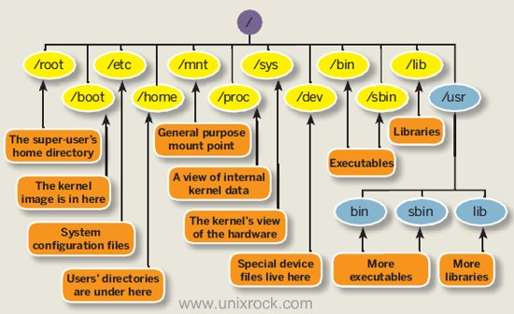
FILE SYSTEM HIERARCHY

Slide 7
IMPORTANT DIRECTORIES
/
/root
/boot
/home
/bin
/lib
/etc
/tmp
/dev
/usr

Slide 8
FILE & DIRECTORY NAMES
A filename is a name used to uniquely identify a computer file stored in a file system. Different file systems impose different restrictions on filename lengths and the allowed characters within filenames.
In computing, a directory is a file system cataloging structure which contains references to other computer files, and possibly other directories. On many computers, directories are known as folders.

Slide 9
ABSOLUTE & RELATIVE PATHNAME
An absolute path is defined as specifying the location of a file or directory from the root directory (/). In other words, we can say that an absolute path is a complete path from start of actual file system from / directory.
Relative path is defined as the path related to the present working directly (pwd). It starts at your current directory and never starts with a /.

Slide 10
CHANGING DIRECTORIES
To change directories from your current working directory, use the command cd. The above command changes directories to the /tmp/ directory. The second word on the command line must be a path. It can either be relative or absolute, and can move one directory or many.
Syntax: $ cd [option] [directory]
$ cd Returns you to your login directory
$ cd - Returns you to your previous working directory
$ cd ~ Also returns you to your login directory
$ cd / Takes you to the entire system's root directory.
$ cd /root Takes you to the home directory of the root user. You must be the root user to access this directory.
$ cd /home Takes you to the home directory, where user login directories are usually stored.
$ cd .. Takes you to the directory one level up.

Slide 11
LISTING DIRECTORY CONTENTS
ls is a Linux shell command that lists directory contents of files and directories.
Syntax: $ ls [options] [file|dir]
Eg:
$ ls -a list all files including hidden file starting with '.'
$ ls -d list directories - with ' */'
$ ls / List root directory.
$ ls .. List parent directory.
$ ls -la List with long format and show hidden files.
$ ls * List all subdirectories.

Slide 12
COPYING FILES & DIRECTORIES AND THE DESTINATION
The cp command will copy files and directories or copy multiple sources
to a destination directory.
Syntax:
Copying Single file/dir:
$ cp [options] <source> <destination>
Copying Multiple files/dir:
$ cp [options] <source1 source2 [...]> <destination_directory>

Slide 13
Common options used with the cp command:
-a – archive, never follow symbolic links, preserve links, copy directories recursively.
-f – if an existing destination file cannot be opened, remove it and try again.
-i – prompt before overwriting an existing file.
-r – copy directories recursively.
Eg:
$ cp data.txt /var/tmp/ Copying a single file to a destination directory.
$ cp data.txt file.csv /var/tmp/ Copying multiple files to a destination directory.
$ cp -r /etc/ /var/tmp/backup/ Copying a directory recursively.

Slide 14
MOVING FILES & DIRECTORIES
The commands to move files and folders in the command line, are actually pretty easy to remember.
mv = move (also used to rename items).
Syntax:
$ mv [Option] <source> <destination>
Options for mv include:
-i for interactive, asks you to confirm if an existing file should be over written.
-f for force, overrides all interactivity and executes the mv instruction without returning any prompts.
-v for verbose, to show the files being moved one by one.
Eg:
$ mv a.txt geek.txt

Slide 15
RENAMING FILE & DIRECTORIES
The mv command is also used to rename items. You simply include the new file name in the location parameter.
Syntax:
$ mv [Option] <OldName> <NewName>
Eg:
$ mv test.txt testing.txt

Slide 16
CREATING FILES & DIRECTORIES
Creating Directories:
The mkdir command in LINUX allows users to create directories as they are referred to in some operating systems. The mkdir command can create multiple directories at once and also set permissions when creating the directory.
Syntax:
$ mkdir <directory_name>
Eg:
$ mkdir mydirectory

Slide 17
Creating Files:
The cat (“concatenate“) command is one of the most frequently used command in Linux/Unix like operating systems. cat command allows us to create single or multiple files, view contain of file, concatenate files and redirect output in terminal or files.
Syntax:
$ cat <File_name>
Eg:
$ cat myfile

Slide 18
NAUTILUS
Nautilus is a very popular file manager so if it isn’t installed for your particular distribution you should be able to find it in the graphical package manager.
Nautilus is the default file manager within Ubuntu Linux.
Nautilus is an open source file manager for the GNOME desktop that gives users a way to manage their files and applications. Nautilus can be used to do things like create folders and documents, display files and folders, search and manage files, and more.

Slide 20
FILE STRUCTURE
INTRODUCTION TO FILE STRUCTURE:
In the Linux file structure files are grouped according to purpose.
Ex: commands, data files, documentation. Parts of a Unix directory tree are listed below. All directories are grouped under the root entry "/". That part of the directory tree is left out of the below diagram.

Slide 21
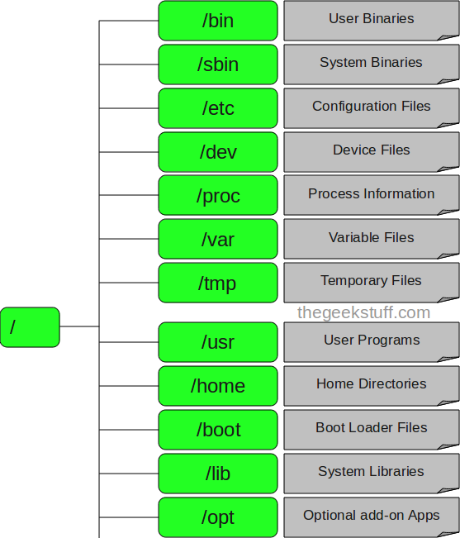
Fig: File Structure

Slide 22
DIRECTORIES IN A FILE STRUCTURE
Generally for arranging all the Files directories or Folders are used. A Folder or Directory is also called as the Container of the Files in which many Sub directors and Files are Stored. So that Files System Specifies the Arrangement of the Files in the System. There are following Directory Structures Available for organizing all the Files.
Available Directory Structures:
Hierarchical
Single Level Directory
Two Level Directory
Acyclic Graph Directory

Slide 23
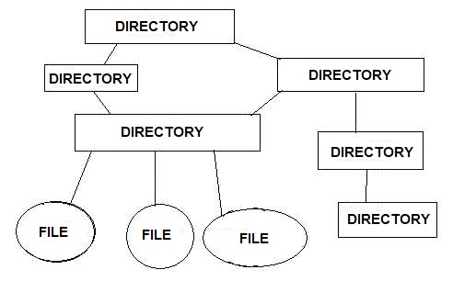
HIERARCHICAL:
In this all the Files are organized in the Form of Parent and Child Relationship. Means in this there is the Parent Directory which contains all the sub Files.

Slide 24
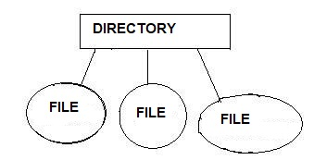
SINGLE LEVEL DIRECTORY:
In this there is a single directory which contains all the Files into. But this is not the best way because all the Files are Stored into the Single Folder So this is very difficult for a user to search a File. There is Only one Directory Which contains the other files So that Many times this is not used because this will Contains Huge Amount of Files and this will Makes difficult for the users to Locate or Find a File.

Slide 25
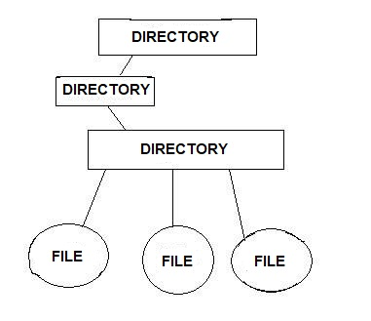
TWO LEVEL DIRECTORIES:
In this directory also contains a another directory and all the files are organized into the sub directory. In the two level a directory also contains sub directory and the files. We can say that a single directory will be the container of many other files and the directories so that when a user wants to access any directory then he has to travel all the other directories and files from that directory.

Slide 26
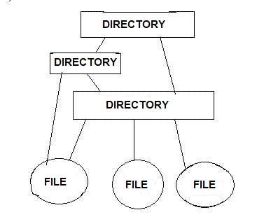
ACYCLIC GRAPH DIRECTORY:
If a directory contains a directory and files then it is called as the acyclic directory in this a single directory contains both directory and files and all the directories are connected with some paths means a single folder or file can be accessible via another files.
In the acyclic graph a single file or a directory can be reached from any file because there are multiple path exists between that file.

